Slide 1


Statistic
Lecture 4
Dr. Nada Abdullah Rasheed
Assist prof. / Computer Science

Slide 2
Syllabus Content
Subject | Lec. No.
Frequency Distributions in SPSS | 3
The Mode | 10
The Median | 11

Slide 3
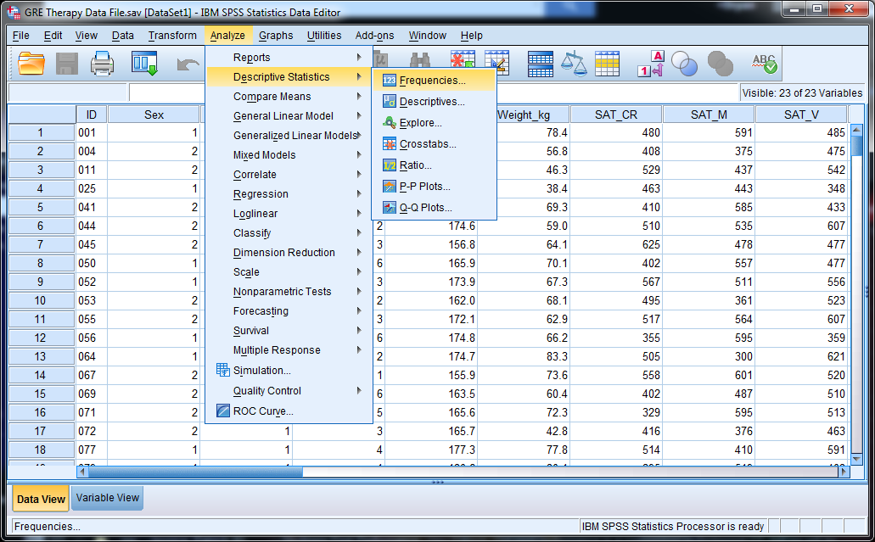
Frequency Distributions and Graphing
2.6 Frequency Distributions in SPSS

Slide 4
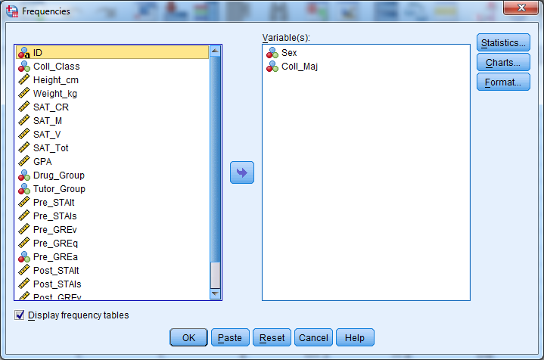
Frequency Distributions and Graphing

Slide 5
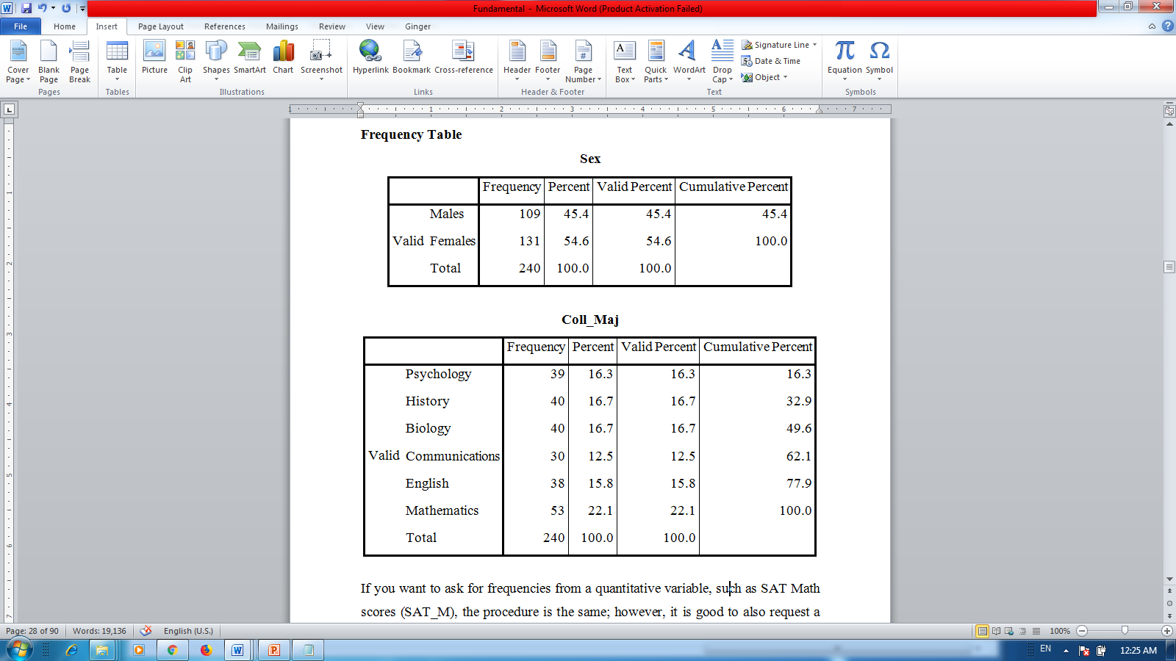
Frequency Distributions and Graphing

Slide 6
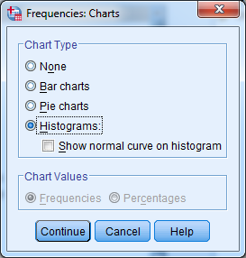
Frequency Distributions and Graphing

Slide 7
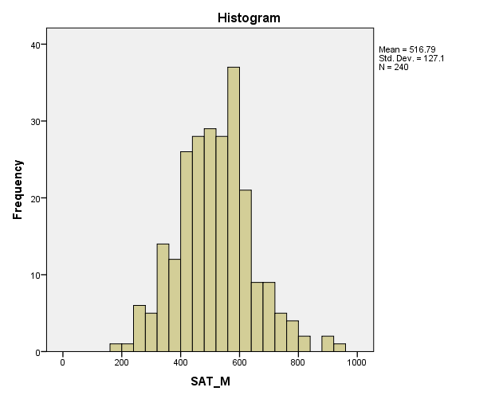
Measures of Central Tendency

Slide 8
Measures of Central Tendency
A descriptive statistic is a such value that describes and represents a set of data. But what value from a distribution should be used as the representative and why is any one value in the data set better than another value? There are three characteristics you need for a good descriptive statistic.

Slide 9
Measures of Central Tendency
A good descriptive statistic should be similar to many scores in a distribution.
It should balance the distribution, so some scores are greater than it and some scores are less, so neither the greater-than or less-than scores are over represented in the descriptive statistic.
A good descriptive statistic should take individual values from the distribution into account so no value is left out.

Slide 10
Measures of Central Tendency
3.1 The Mode:
This section uses the following set of n = 50 quiz scores (X), which have a range of 0 - 10:
10 10 10 9 9 9 9 8 8 8 8 8 7 7 7 7 7 7 6 6 6 6 6 6 6
5 5 5 5 5 5 5 5 5 4 4 4 4 4 4 4 4 3 3 3 3 3 2 2 1
The mode (Mo) has been the most frequently occurring score in a data set. IN the data set above, X = 5 has the greatest frequency (f = 9); hence, the mode is 5.

Slide 11
Measures of Central Tendency
3.2 The Median:
The median (Md) is the middle score of a distribution, because 50% of the scores in a distribution are greater than the median and 50% are less than the median
Md = (N + 1)/2

Slide 12
Measures of Central Tendency
If there is an even number of scores, you must find the two positions surrounding the median, identify the values at those two locations, and take the average of those values. Hence, with an even number of scores, the median is the average of the two scores that surround the median’s position.
Md = N/2 and (N + 2)/2

Slide 13
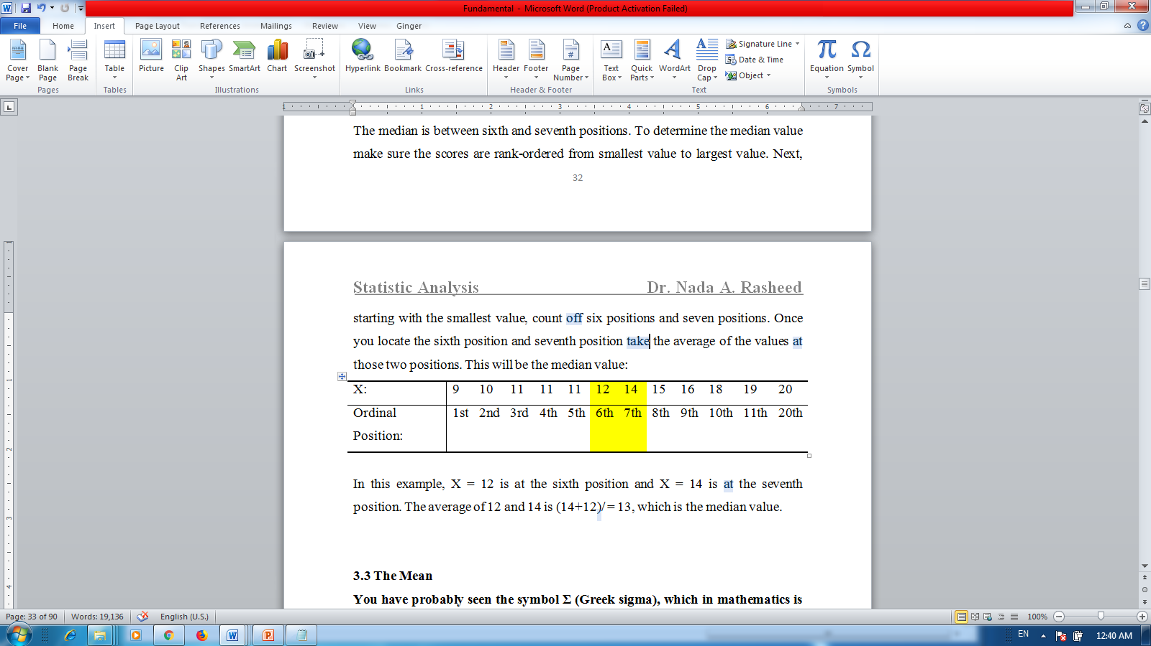
Measures of Central Tendency

